Slide 1
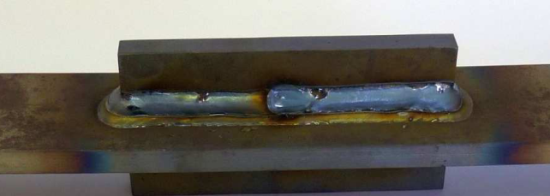
Has been accepted 2022-11-03.
Photo – cannot be revised as such

Slide 2
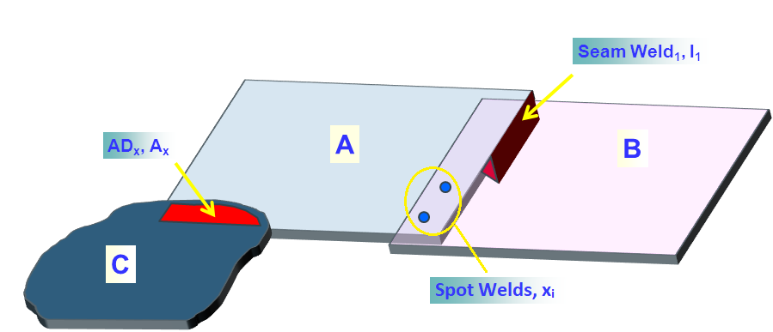
“overlay text” added
Seam Weld₁ , I₁
AD_{x}, A_{x}
A
B
C
Spot Welds, x_{i}

Slide 3
This graphic can be edited: Just double-click it!

Slide 4
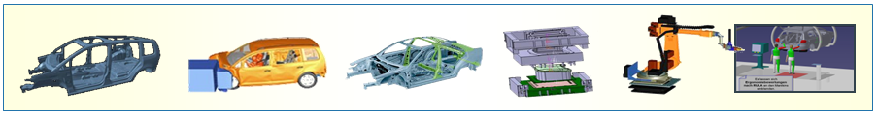
Has been accepted 2022-11-03.

Slide 5
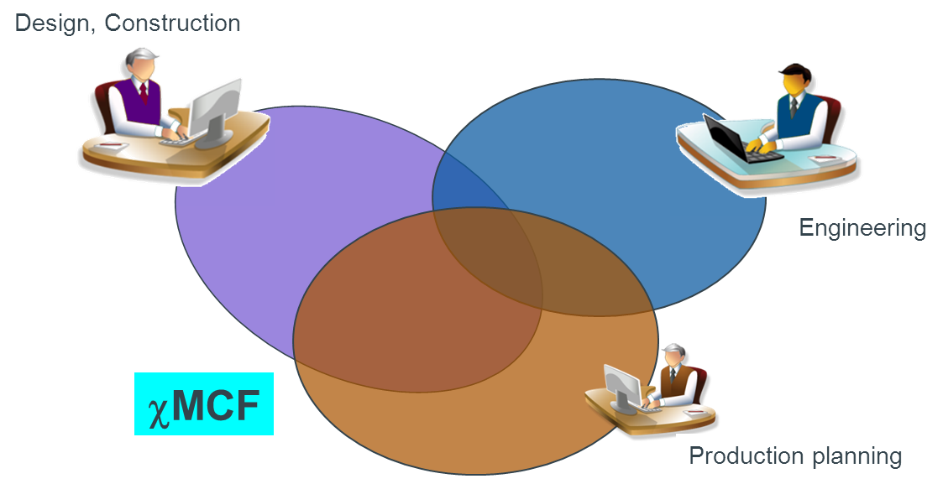
“overlay text” added
_{Design, Construction}
_{Engineering}
_{χMCF}
_{Production Planning}

Slide 6
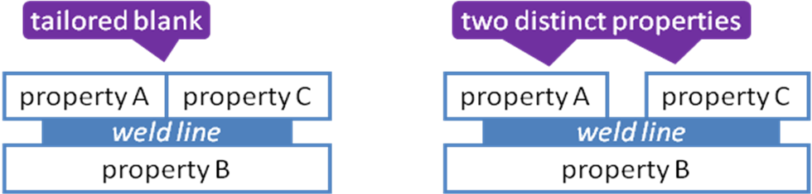
Bitmap substitutable by original PowerPoint-elements.
tailored blank
Two distinct properties
two distinct properties
property A
property C
property A
property C
weld line
weld line
property B
property B

Slide 7
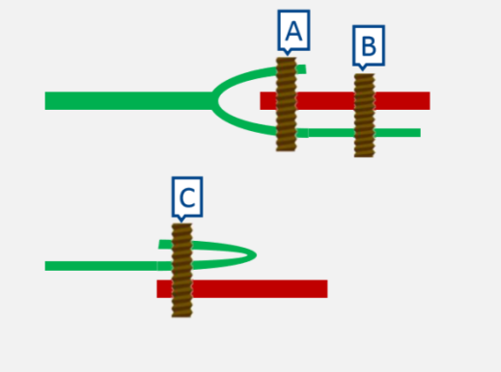
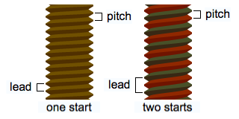
Bitmap substitutable by original PowerPoint-elements.
A
B
C
Notes:
Review 2023-01-25: Red and green to be replaced by black / shades of gray.

Slide 8
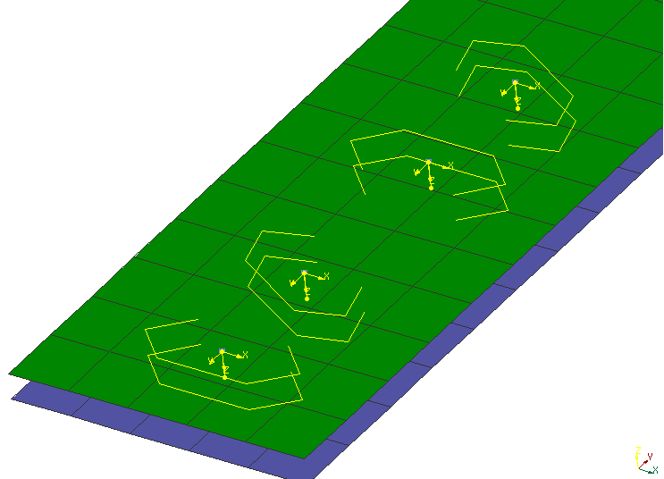
Has been accepted 2022-11-03.

Slide 9
Has been accepted 2022-11-03.
dome
large flange
countersunk

Slide 10
Has been accepted 2022-11-03.
clearance (blind side)
grip
before riveting
after
riveting
application example

Slide 11
Has been accepted 2022-11-03.
Thin / Thick Assembly
Soft / Hard Assembly
Satisfactory
Good
Soft Part
Good
Poor
Soft Part
Better

Slide 12
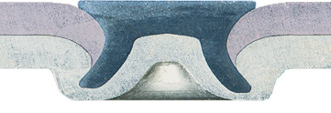
Has been accepted 2022-11-03.
punch
blank holder
rivet head diameter
die
bottom thickness
undercut
rivet diameter
(undeformed)

Slide 13
Has been accepted 2022-11-03.
solid rivet
semi tubular rivet
shoulder rivet
split rivet

Slide 14
Has been accepted 2022-11-03.
head diameter
shoulder
length
shoulder
diameter
length
tennon
diameter
hole depth
tennon
length
hole diameter

Slide 15
Has been accepted 2022-11-03.
rivet length
grip
min_grip < T1+T2 < max_grip

Slide 16
Has been accepted 2022-11-03.
4
3
1
3
1
2
2
5
4
1 – non-weldable part/material
2 – weldable part/material
3 – insert or plug
4 – electrodes
5 – stop surface
Notes:
Review 2023-01-25:
Text to be separated from image.
Follow https://www.iso.org/sites/directives/current/part2/index.xhtml example 2: Legend between image and caption.
In the legend, no dash between nr. and text.

Slide 17
Has been accepted 2022-11-03.
Clinched rivet stud (threaded)
clinched ball stud
Notes:
Review 2023-01-25:
https://www.iso.org/sites/directives/current/part2/index.xhtml
Follow example in “28.3.2 Subfigures“

Slide 18
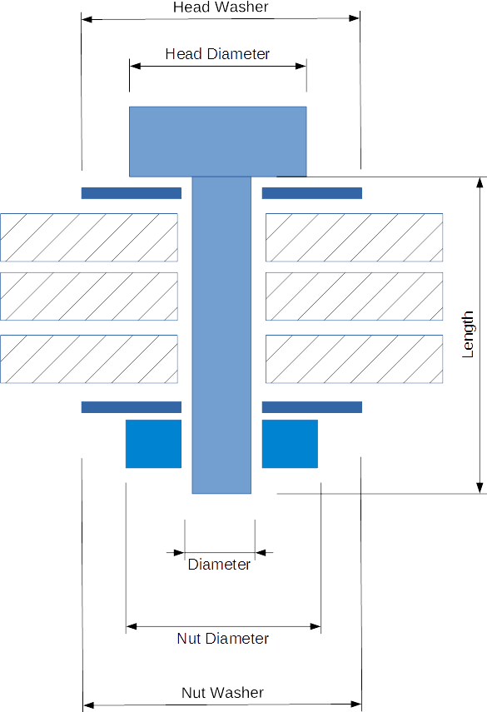
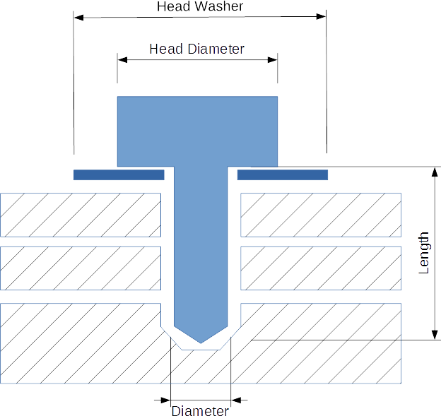
Bitmap substitutable by original PowerPoint-elements.
Head Washer
Head Diameter
Head Washer
Head Diameter
Length
Length
Bolt Representation
Screw Representation
Diameter
Diameter
Nut Diameter
Nut Washer

Slide 19
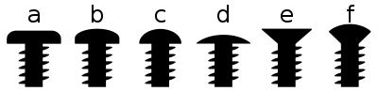
“overlay text” added
a
b
c
d
e
f
Button head
Pan head
Round head
Truss head
Countersunk
Countersunk (oval) Raised
Source: https://en.wikipedia.org/wiki/Screw
Notes:
Source:
<https://en.wikipedia.org/wiki/Screw>, and therein:
<http://upload.wikimedia.org/wikipedia/commons/thumb/6/61/Screw_head_types.svg/400px-Screw_head_types.svg.png>

Slide 20
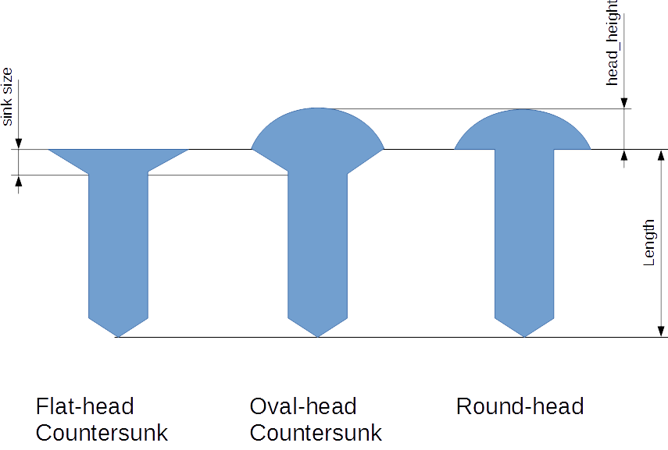
Bitmap substitutable by original PowerPoint-elements.
head height
sink size
Length
Flat-head
Countersunk
Oval-head
Countersunk
Round-head

Slide 21
“overlay text” added
pitch
pitch
lead
lead
one start
two starts
Source: https://en.wikipedia.org/wiki/Screw_thread

Slide 22
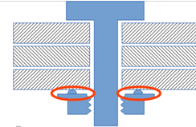
Bitmap substitutable by original PowerPoint-elements.

Slide 23
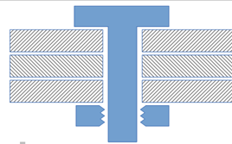
Bitmap substitutable by original PowerPoint-elements.

Slide 24
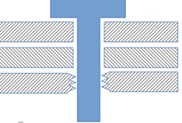
Bitmap substitutable by original PowerPoint-elements.

Slide 25
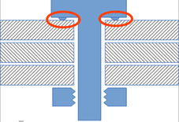
Bitmap substitutable by original PowerPoint-elements.

Slide 26
Has been accepted 2022-11-03.

Slide 27
Has been accepted 2022-11-03.
Placing screw (w/ speed & pressure)
Heating, Forming material
Forming thread & tighten screw

Slide 28
Has been accepted 2022-11-03.
thread length
t₁
t₂
length

Slide 29
Has been accepted 2022-11-03.
d_{D}
d_{w}
t₁
t₂

Slide 30
Has been accepted 2022-11-03.
d_{D}
d_{V}
t₁
t₂

Slide 31
Has been accepted 2022-11-03.
_{punch side material}
_{neck}
t₁
t₂
_{die side material}
_{Cap thickness}
_{interlock}
_{button diameter}

Slide 32
Has been accepted 2022-11-03.
_{Punch}
_{Clinch Joint}
_{Fixed Die}
_{Openable Die}

Slide 33
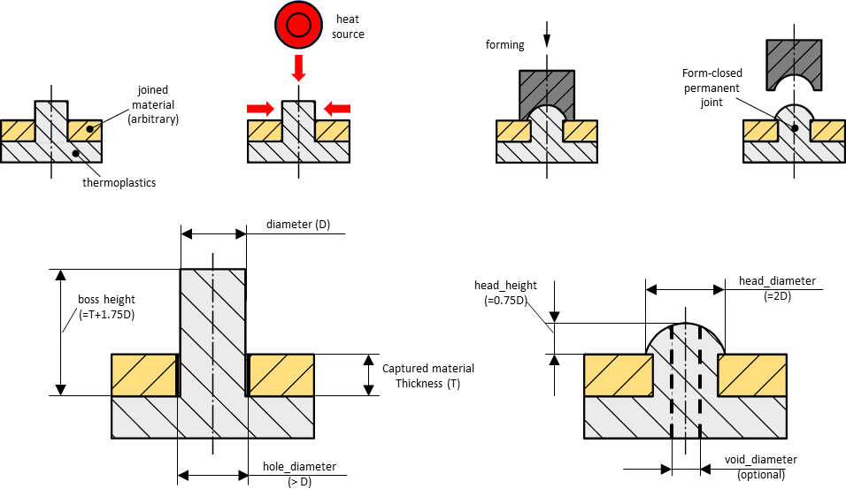
“overlay text” added
heat
source
forming
form-closed
permanent joint
joined
material
(arbitrary)
thermoplastics
Diameter (D)
head_height
(=0.75D)
head_diameter
Boss height
(=T+1.75D)
(=2D)
Captured Material
Thickness (T)
hole_diameter
void_diameter
(>D)
(optional)

Slide 34
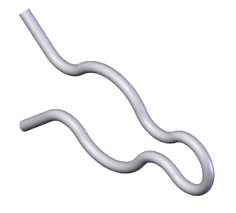
Has been accepted 2022-11-03.

Slide 35
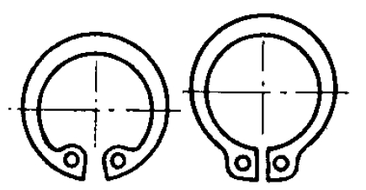
Has been accepted 2022-11-03.

Slide 36
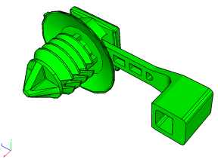
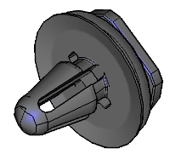
Has been accepted 2022-11-03.

Slide 37
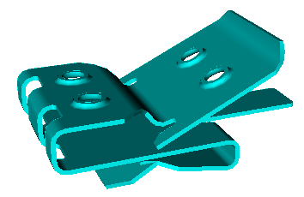
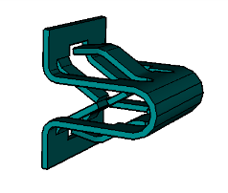
Has been accepted 2022-11-03.

Slide 38
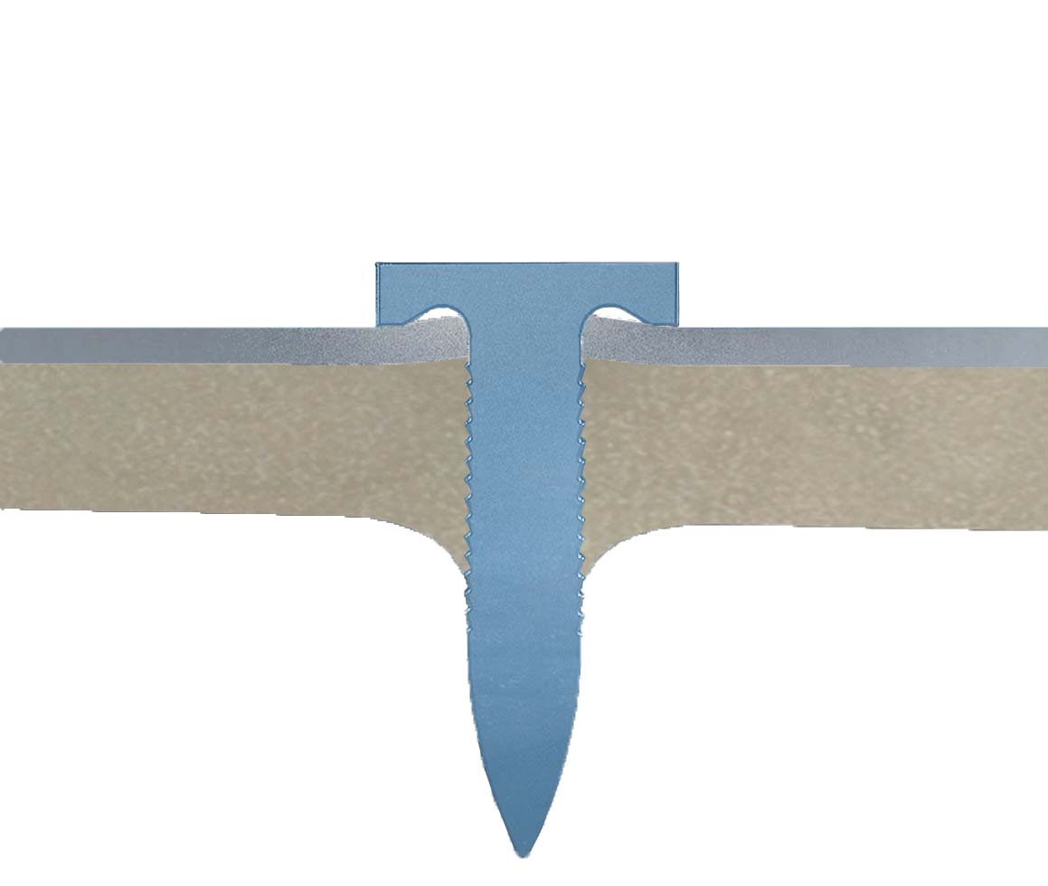
Has been accepted 2022-11-03.
_{punch}
_{blank holder}
_{joined sheet}
_{base part}
_{nail}

Slide 39
Has been accepted 2022-11-03.
_{head_height}
_{head_diameter}
_{cylinder_length}
_{length}
Examples of different nail types
_{shaft_diameter}

Slide 40
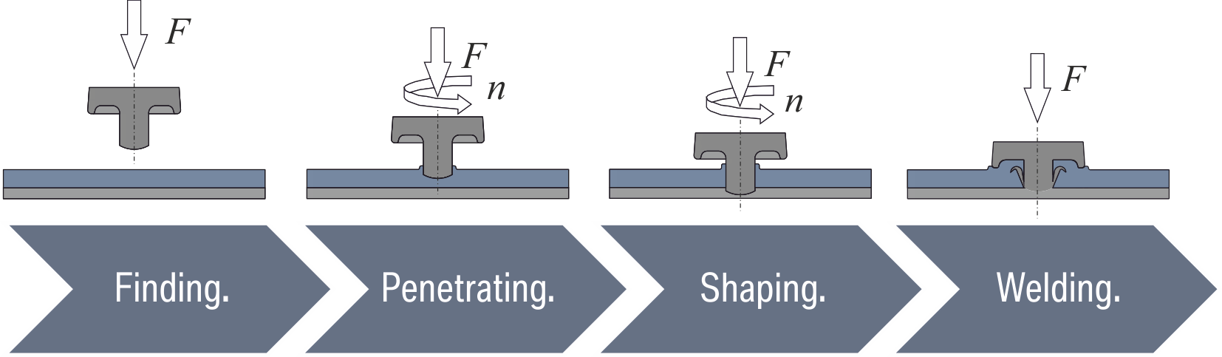
Screenshot

Slide 41
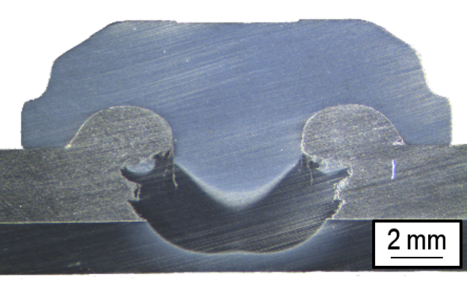
Photo of a physical specimen – cannot be revised as such

Slide 42
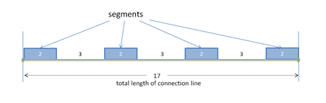
Bitmap substitutable by original PowerPoint-elements.
segments
2
3
2
3
2
3
2
17
total length of connection line

Slide 43
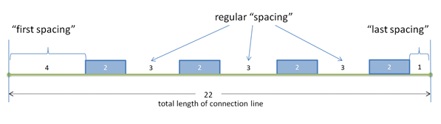
Bitmap substitutable by original PowerPoint-elements.
regular “spacing”
“first spacing”
“last spacing”
4
2
3
2
3
2
3
2
1
22
total length of connection line

Slide 44
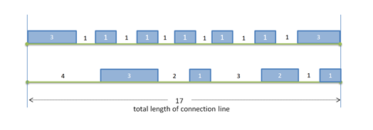
Bitmap substitutable by original PowerPoint-elements.
3
1
1
1
1
1
1
1
1
1
1
1
3
4
3
2
1
3
2
1
1
17
total length of connection line

Slide 45
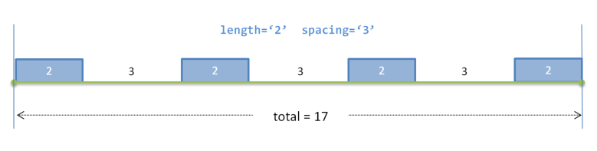
New, 2023-01-24
Bitmap substitutable by original PowerPoint-elements.
length=‘2’ spacing=‘3’
2
3
2
3
2
3
2
total = 17

Slide 46
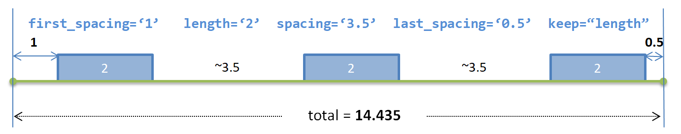
New, 2023-01-24
Bitmap substitutable by original PowerPoint-elements.
first_spacing=‘1’ length=‘2’ spacing=‘3.5’ last_spacing=‘0.5’ keep=“length”
1
0.5
2
~3.5
2
~3.5
2
total = 14.435

Slide 47
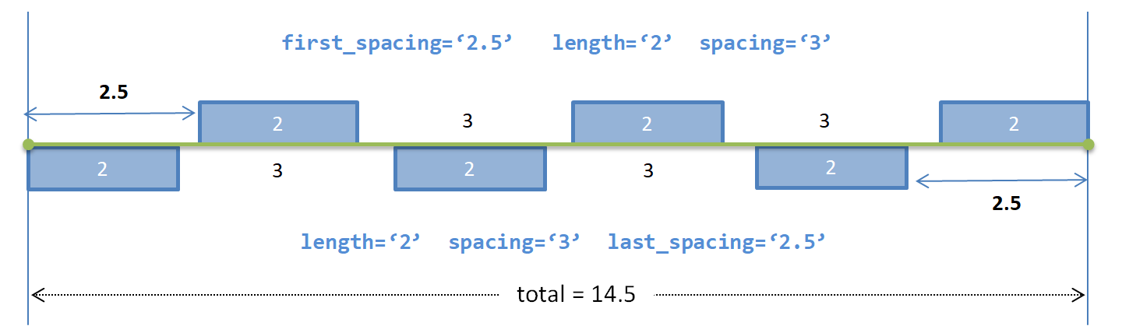
New, 2023-01-24
Bitmap substitutable by original PowerPoint-elements.
first_spacing=‘2.5’ length=‘2’ spacing=‘3’
2.5
2
3
2
3
2
2
3
2
3
2
2.5
length=‘2’ spacing=‘3’ last_spacing=‘2.5’
total = 14.5

Slide 48
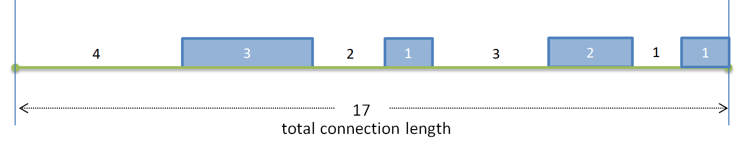
New, 2023-01-24
Bitmap substitutable by original PowerPoint-elements.
4
3
2
1
3
2
1
1
17
total length of connection line

Slide 49
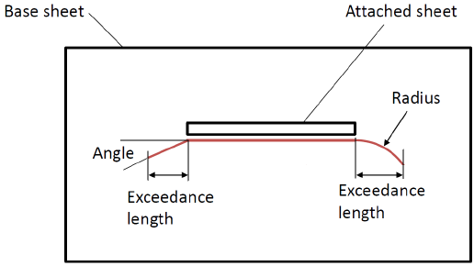
Suggestion: drop this figure

Slide 50
Bitmap substitutable by original Excel table, embedded in Word

Slide 51
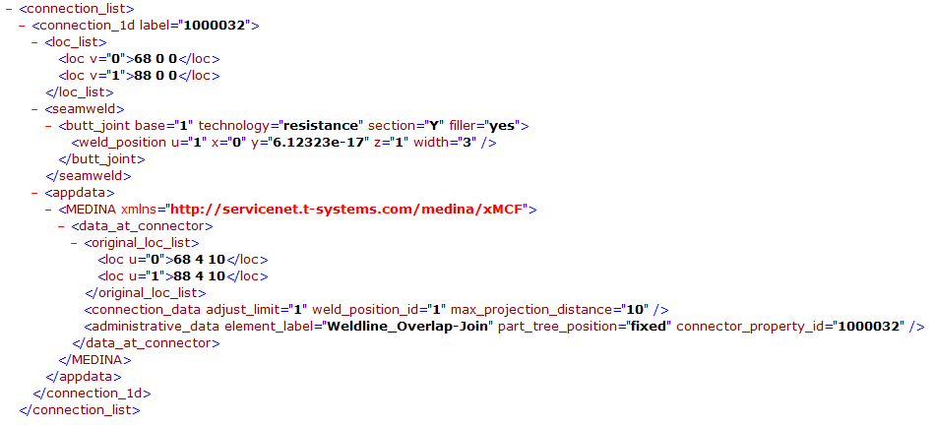
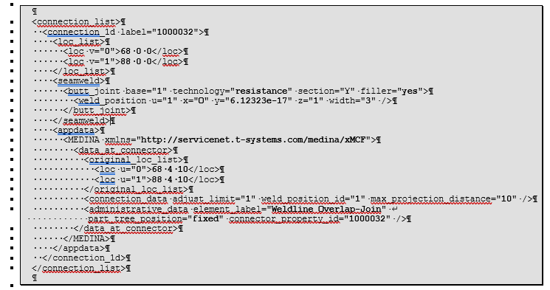
Figure was replaced by text, directly in Word file.

Slide 52
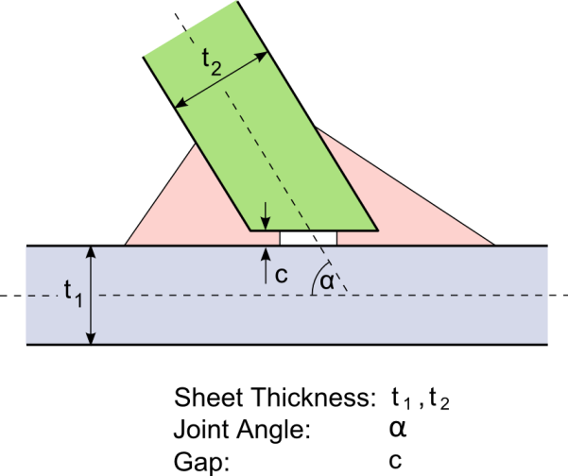
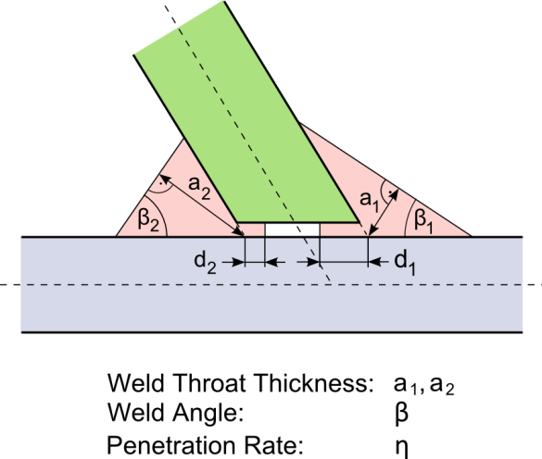
Combined from Fig. 71 with some additional text.

Slide 53
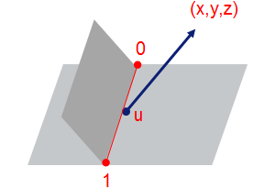
Bitmap substitutable by original PowerPoint-elements.
(x,y,z)
0
u
1

Slide 54
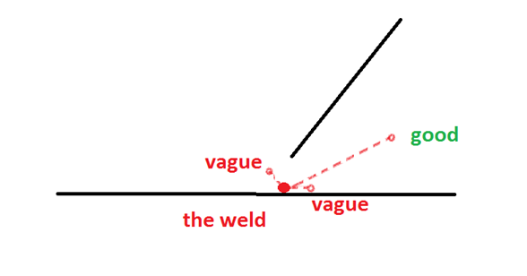
Bitmap substitutable by original PowerPoint-elements.
good
vague
vague
the weld

Slide 55
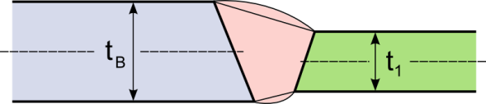
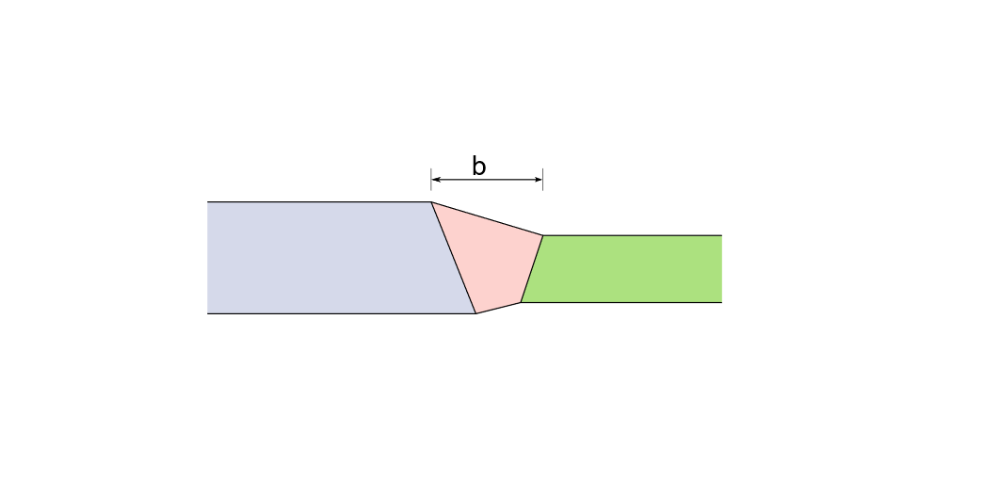
Editable SVG available.

Slide 56
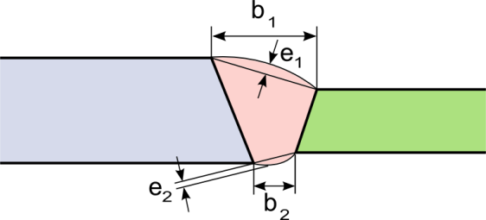
Editable SVG available.

Slide 57
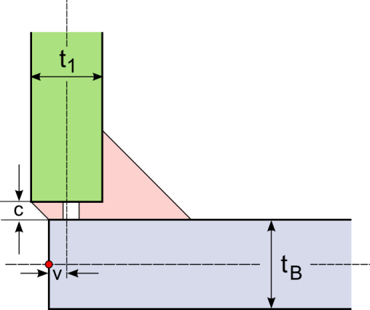
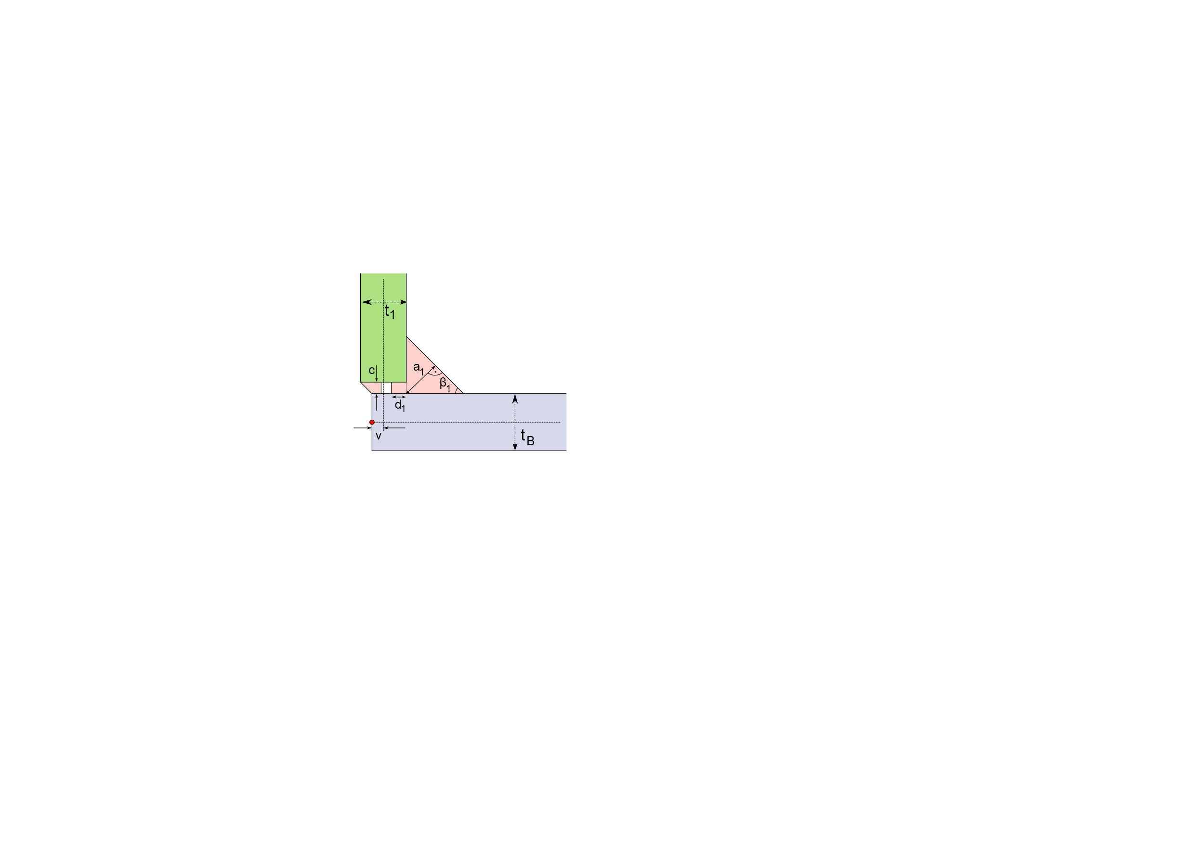
Editable SVG available.

Slide 58
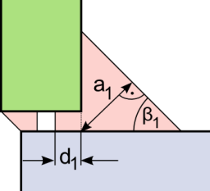
Editable SVG available.

Slide 59
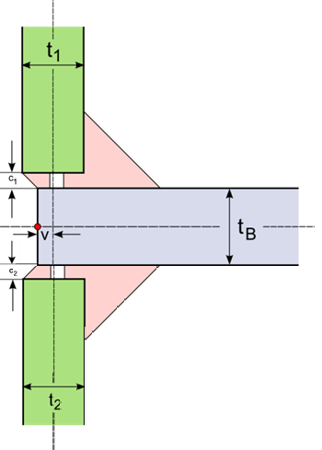
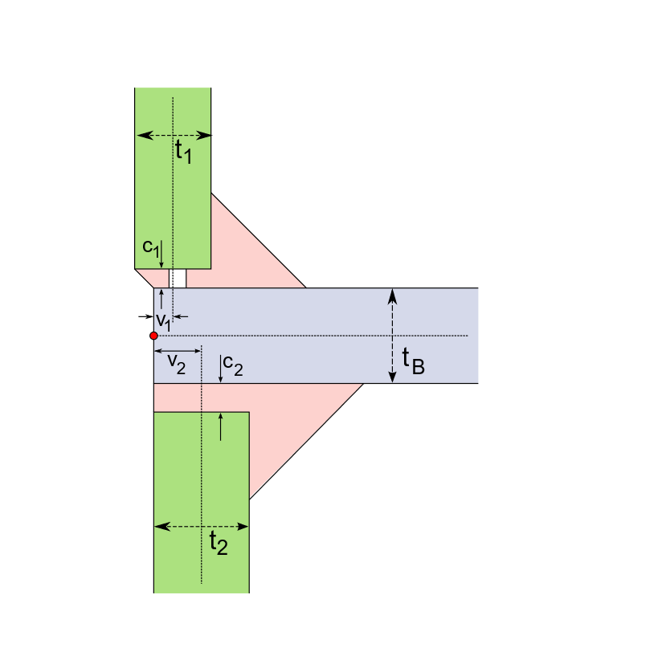
Editable SVG available.

Slide 60
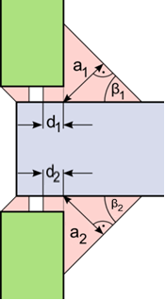
Editable SVGs available.

Slide 61


Editable SVG available.

Slide 62

Editable SVG available.

Slide 63


Editable SVG available.

Slide 64

Editable SVG available.

Slide 65


Editable SVG available.

Slide 66

Editable SVG available.

Slide 67


Editable SVG available.

Slide 68

Combined from Fig. 65/66.

Slide 69


Editable SVG available.

Slide 70


Cut from Fig. 69.

Slide 71


Editable SVG available.

Slide 72

Cut from Fig. 71.

Slide 73


Editable SVG available.

Slide 74

Editable SVG available.

Slide 75

Can be derived from Fig. 71.
Overlay text added
t₁
c₁
t_{B}
α₁
α₂
c₂
t₂

Slide 76

Can be derived from Fig. 71.
Overlay text added
a₂
a₁
β₁
β₂
d₂
d₁
d₄
d₃
β₄
β₃
a₄
a₃

Slide 77

Bitmap substitutable by original PowerPoint-elements.
t₁
c
t_{B}

Slide 78

Bitmap substitutable by original PowerPoint-elements.
b

Slide 79

“overlay text” added
Inner Panel
Adhesive
Region C
Region B
visible from
inside
Outer Panel
Region A

Slide 80

“overlay text” added
A|mm
A|mm
ADHESIVE
ADHESIVE

Slide 81

“overlay text” added
CORNER RELIEF NOTCH
CORNER
RELIEF NOTCH
ADHESIVE
ADHESIVE
BOND WIDTH MINIMUM
BOND WIDTH MINIMUM

Slide 82

“overlay text” added
A|mm
ADHESIVE
BOND WIDTH
REINFORCEMENT

Slide 83

Bitmap substitutable by original PowerPoint-elements.
10 cm
spacing=“1.0”
1 cm

Slide 84

Bitmap substitutable by original PowerPoint-elements.
spacing=“1.0”
margin=“1.5”
1.5 cm
1 cm
1.5 cm

Slide 85

Bitmap substitutable by original PowerPoint-elements.
10 cm
spacing=“1.5”
margin=“1.5”
2.0 cm
1.5 cm
2.0 cm
margin is relaxed

Slide 86

Bitmap substitutable by original PowerPoint-elements.
10 cm
spacing=“1.5”
margin=“1.5”
1.5 cm
1.75 cm
1.5 cm
spacing is relaxed

Slide 87

Has been accepted 2022-11-03.

Slide 88

Bitmap substitutable by original PowerPoint-elements.
“spacing”
“first spacing”
“last spacing”
total length
“length”
8329_ed1figA1

Slide 89

Bitmap substitutable by original PowerPoint-elements.
L
m_{first}
m_{last}
l
s
l
s
l
s
l
L_{total}
8329_ed1figA2

Slide 90


Editable SVG available.
8329_ed1figB1

